Slide 1
City BuDGET
TEAM F

Slide 2
TEAM
GAURAVDEEP SINGH BINDRA
HAOKUN WU
NAIMA ABRAR
MARIA SOFIA MERCADO AREVALO
JASON KWAN
ALEX BAPTISTA

Slide 3
Goals OF THE PROJECT
Showcase how Boston city budget is distributed across Cabinets, Departments and Geography
Portray how it has changed over time
Evaluate city’s financial management
Providing valuable insights that can help the stakeholders make decisions
Suggest ideas which can help distribute budget in a way which empowers and helps more boston residents

Slide 4
MOTIVATION FOR THE PROJECT
Project has the potential to impact the lives of millions of Boston residents
It will help bring transparency and bring accountability to the budgeting process promoting informed governance practices
Data driven approach can highlight areas of focus and increase efficiency in use of public funds
Can help engage citizens in the budgeting process

Slide 5
DATA WORKED ON
OPERATING BUDGET(2021-24)
CAPITAL BUDGET(2024-28)
REVENUE(2021-24)
SOCIO ECONOMIC DATA(2015-19)

Slide 6
RESULTS AND VISUALIZATIONS

Slide 7
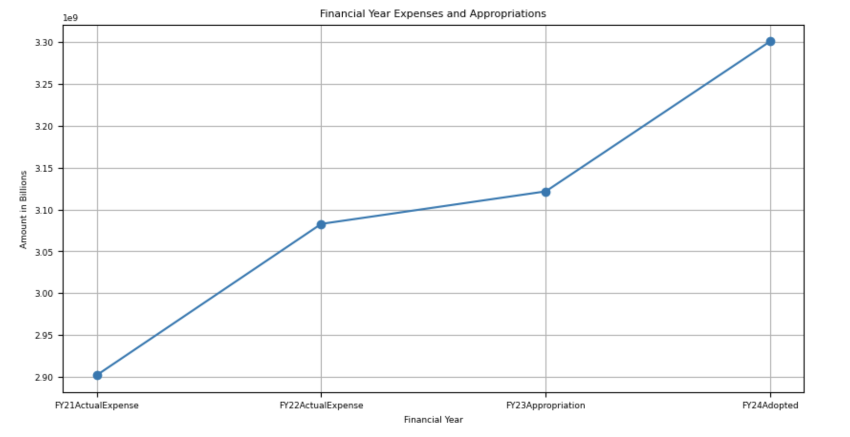
TOTAL YEARLY OPERATING BUDGET 2021-24
7.5%
INCREMENT IN OPERATING BUDGET FROM 2021 TO 2023

Slide 8
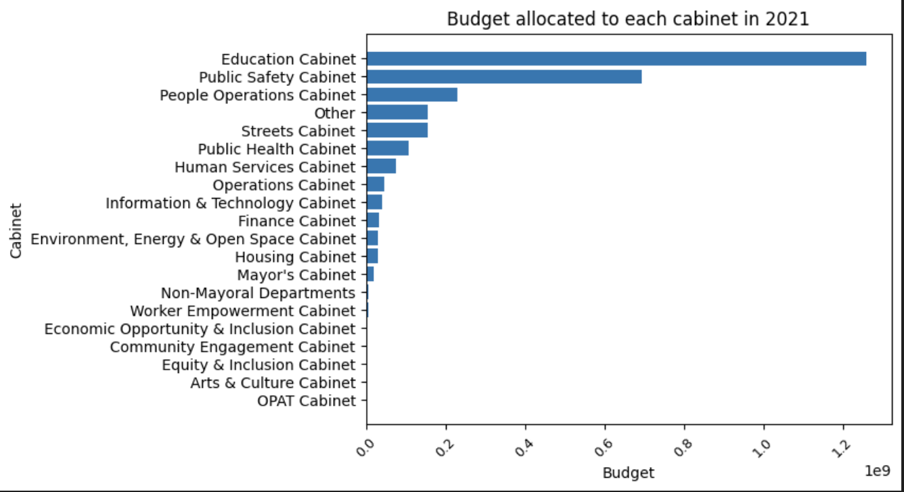
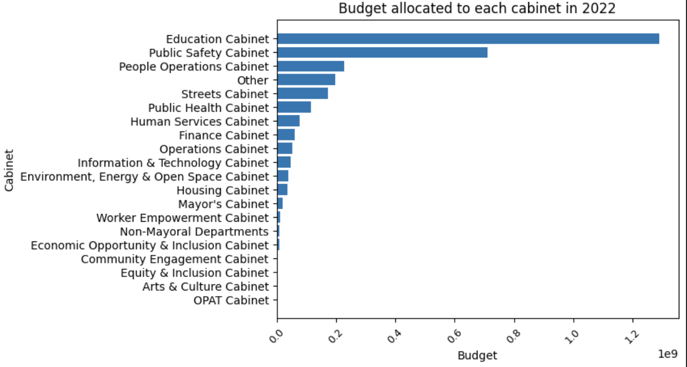
OPERATING BUDGET - DISTRIBUTION BY CABINET
2021 vs 2022
Only Non-Mayoral and Worker Empowerment switch positions. Otherwise the order is same and relative percentages are also similar

Slide 9
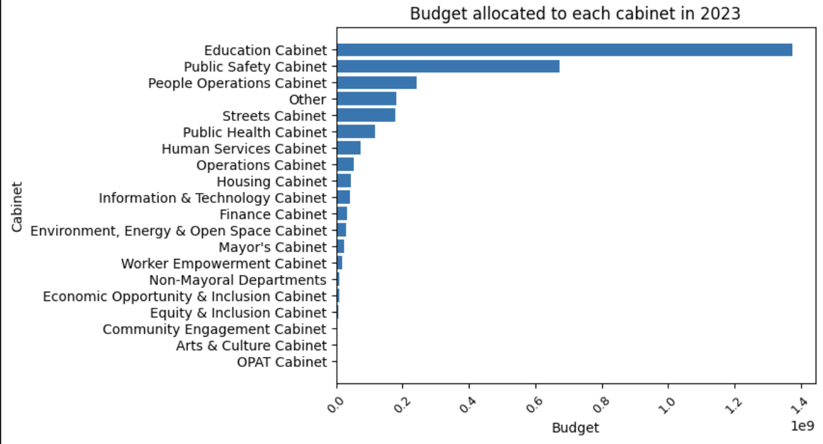
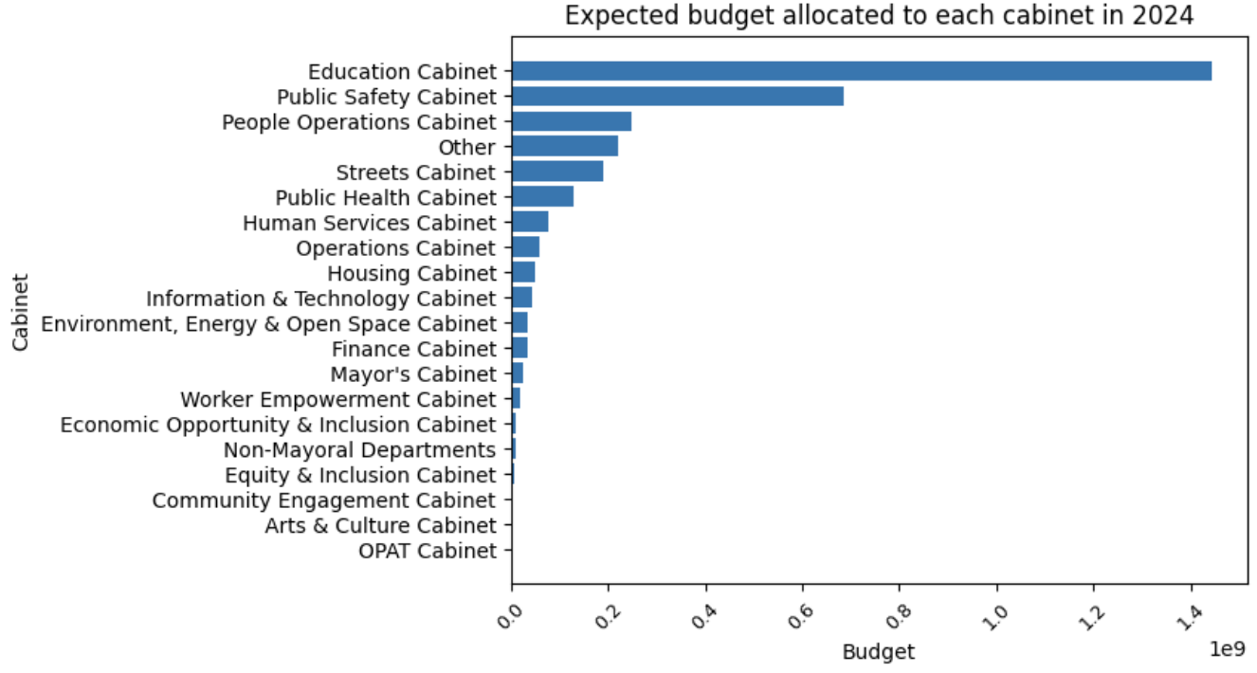
2023 vs 2024
Couple of relative order switches

Slide 10
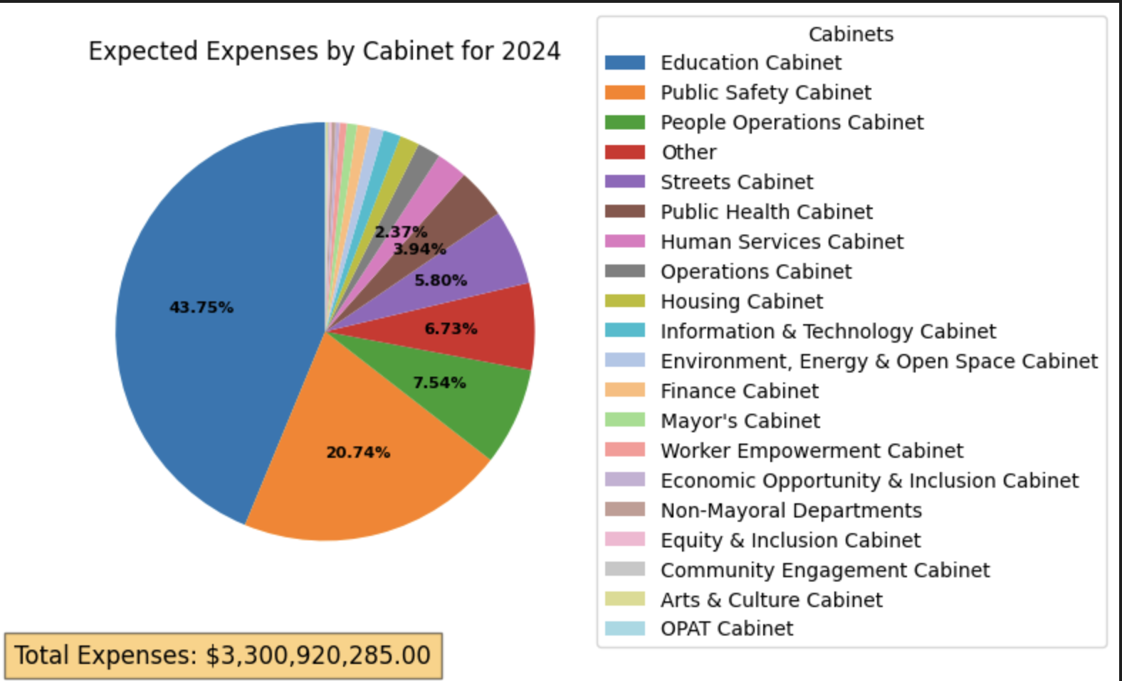
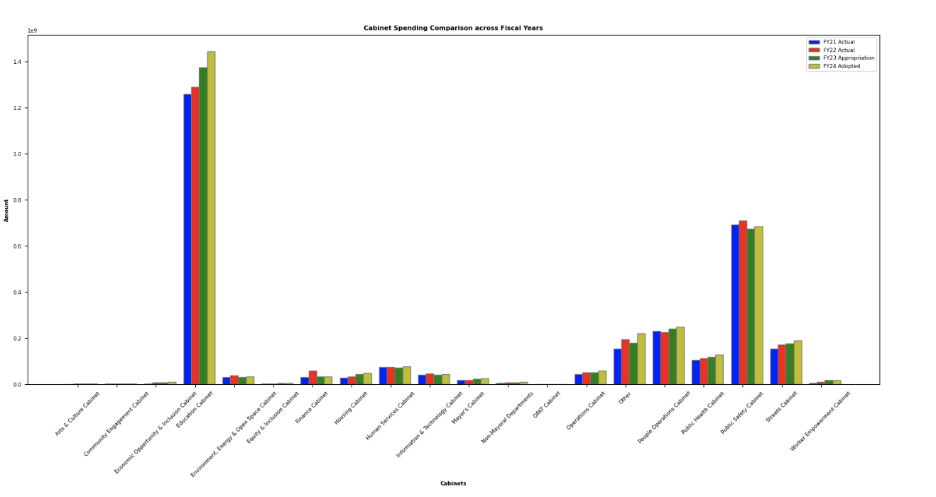
PERCENTAGE BREAKDOWN
Comparison over 2021-24

Slide 11
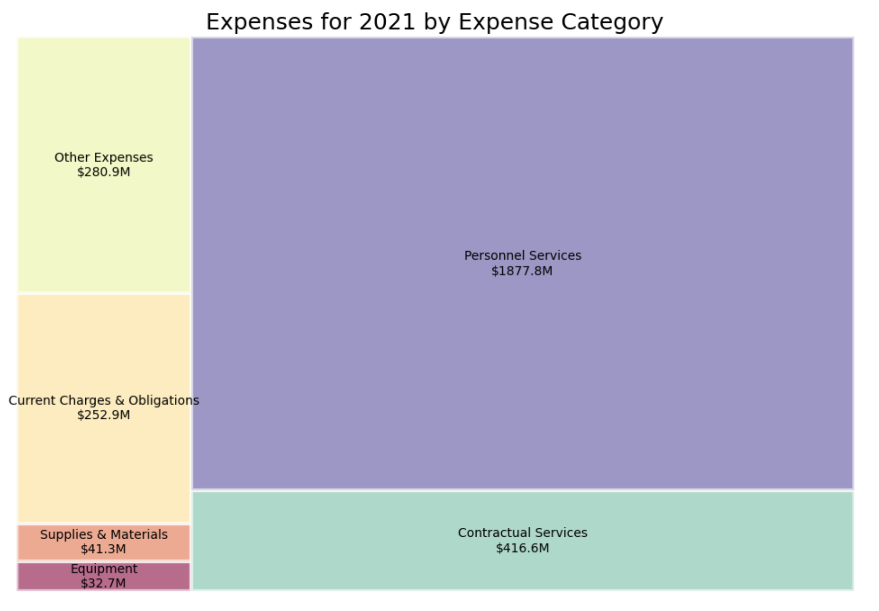
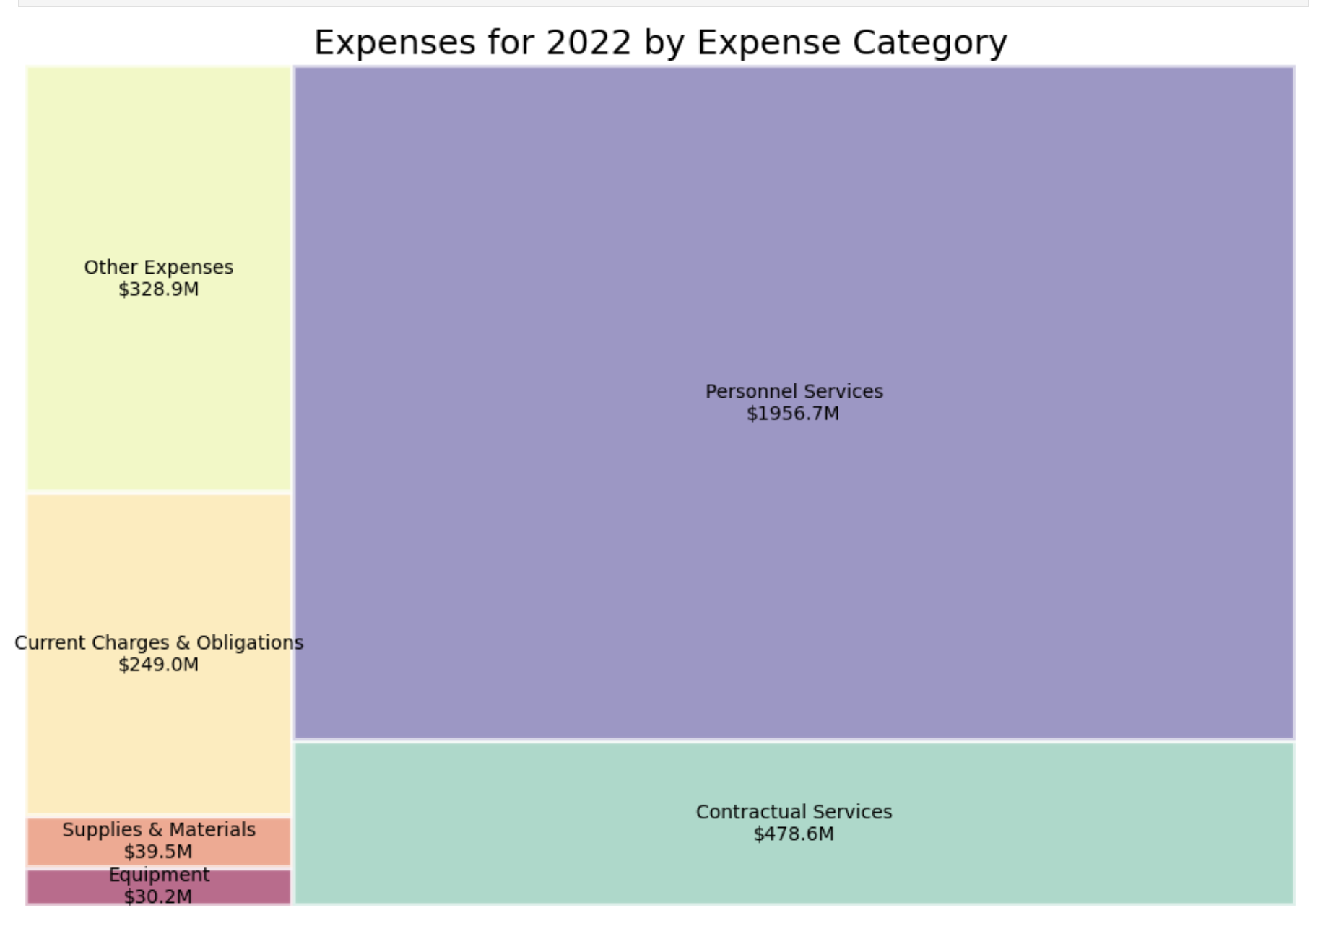
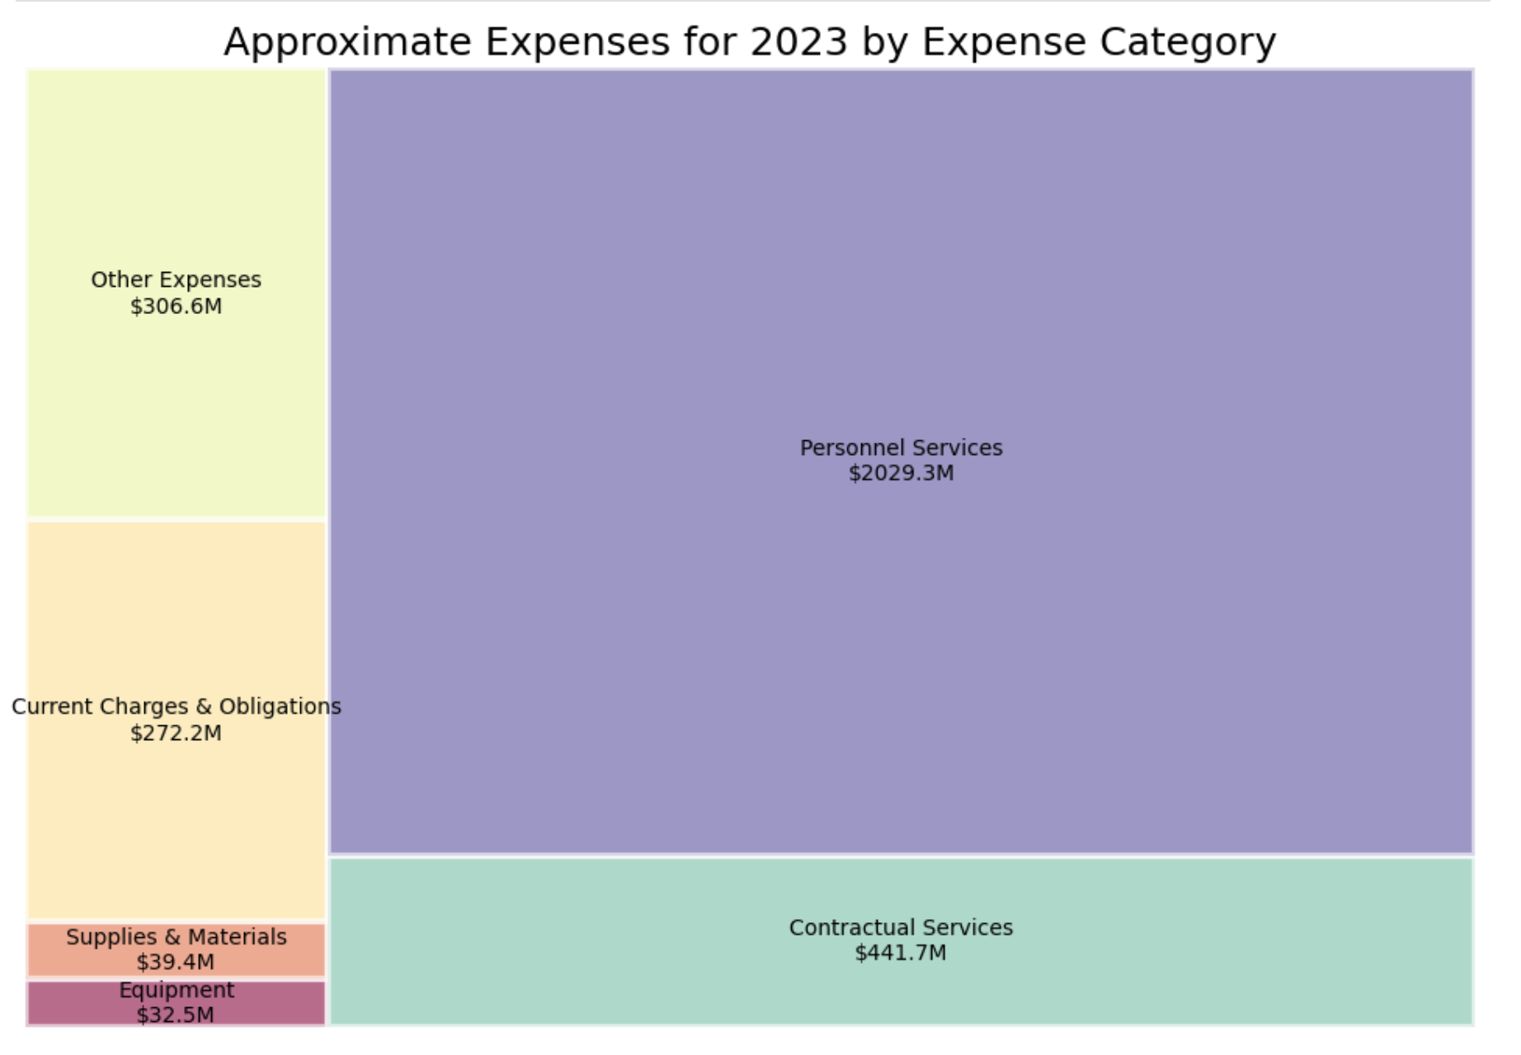
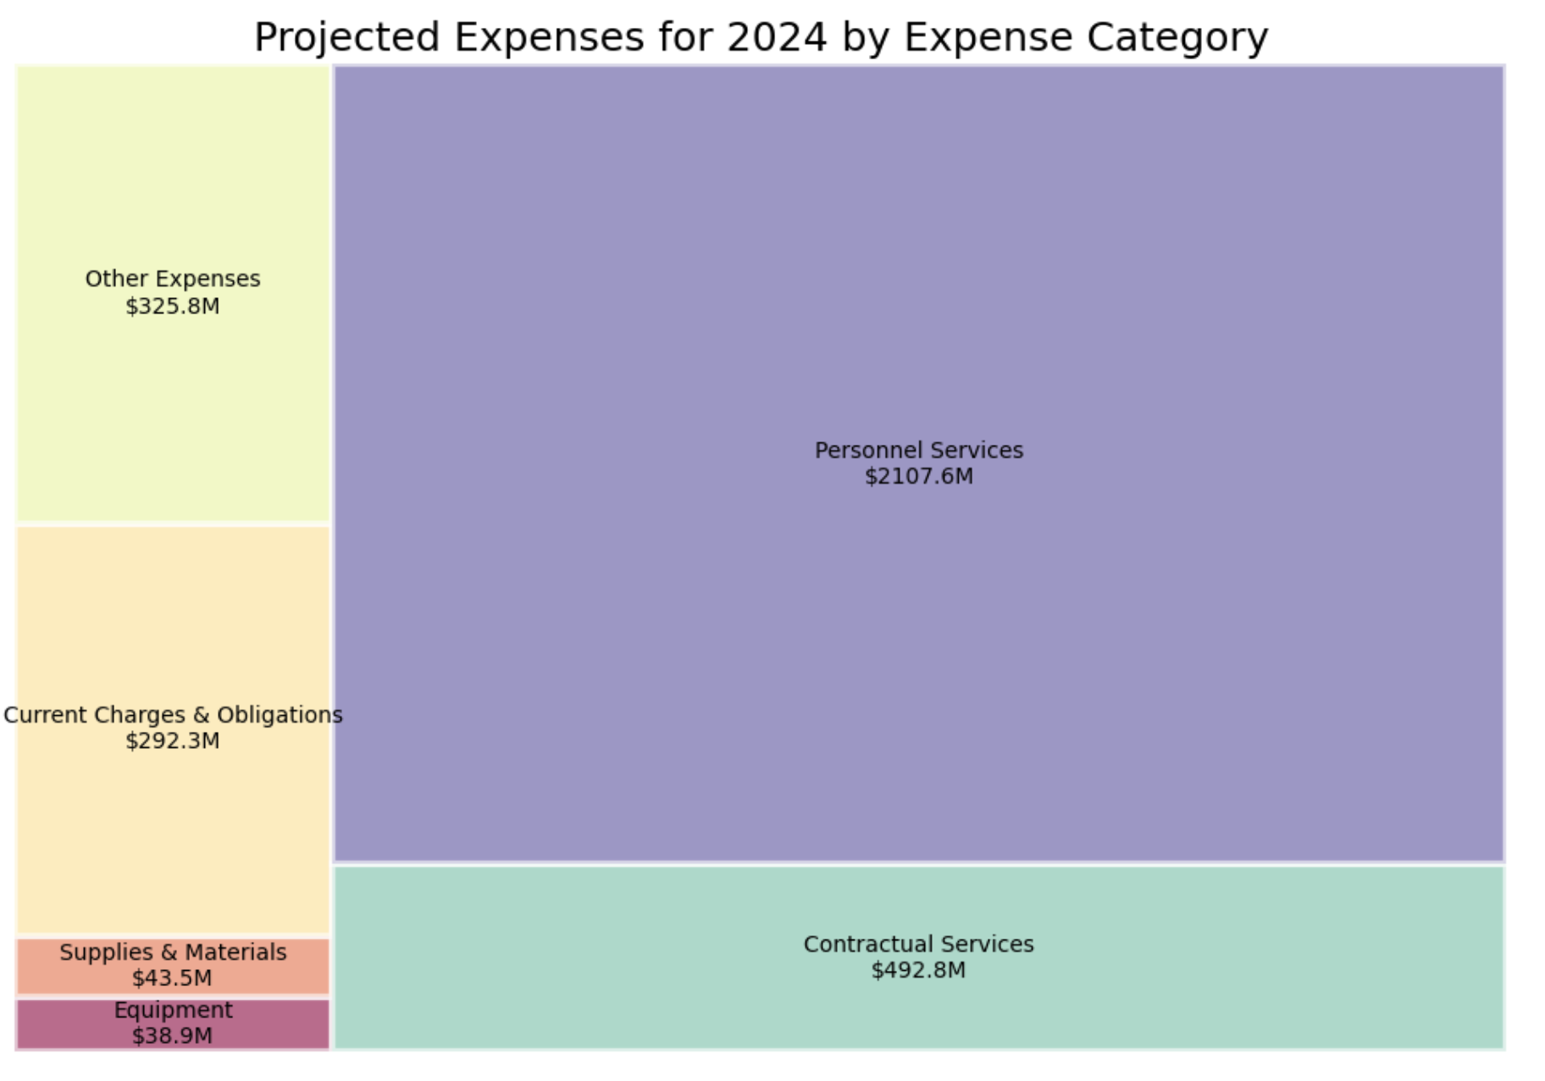
DISTRIBUTION BY EXPENSE CATEGORY (2021-24)

Slide 12
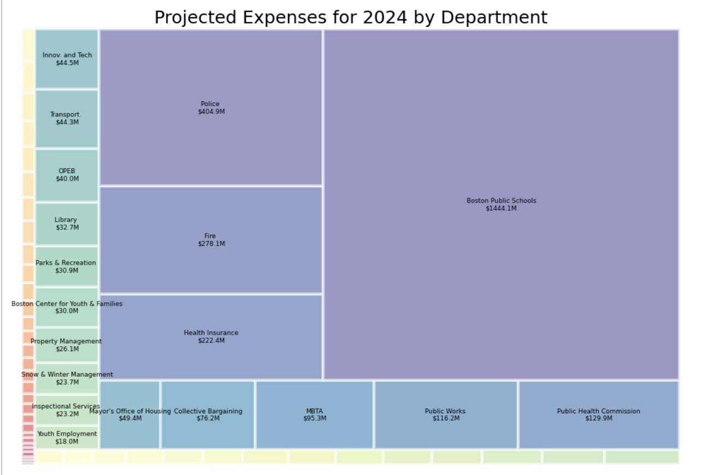
DISTRIBUTION BY DEPARTMENTS

Slide 13
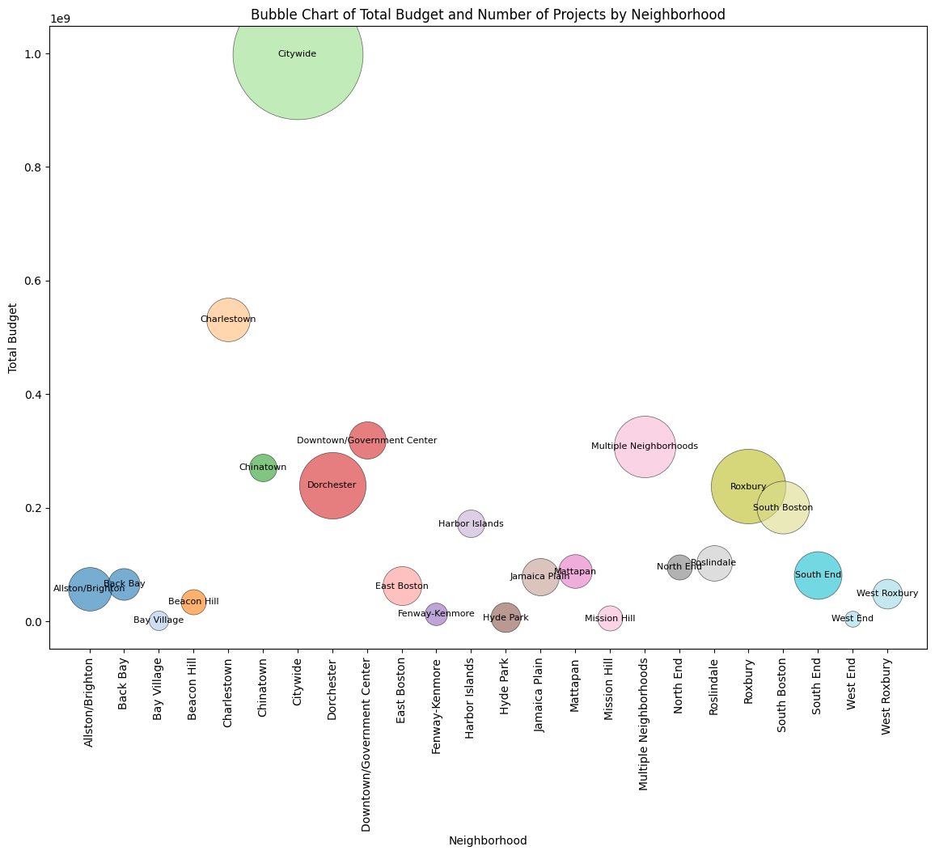
CAPITAL BUDGET
Distribution by Neighborhood

Slide 14
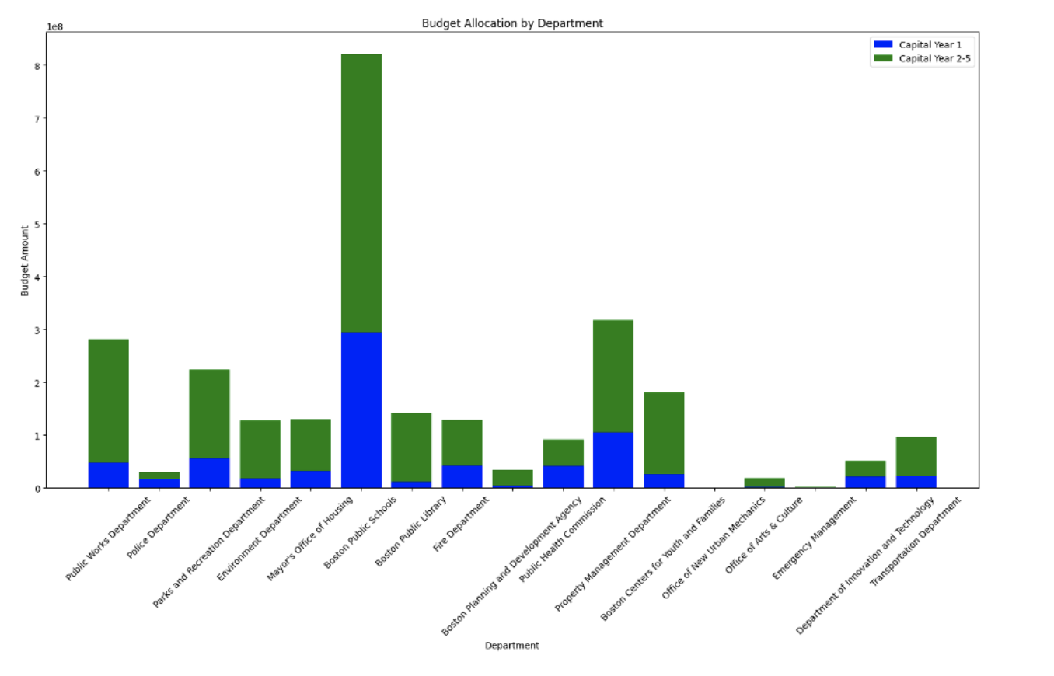
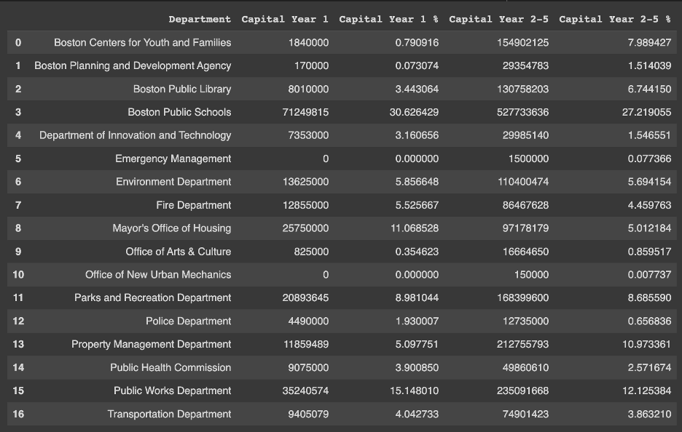
By dept

Slide 15
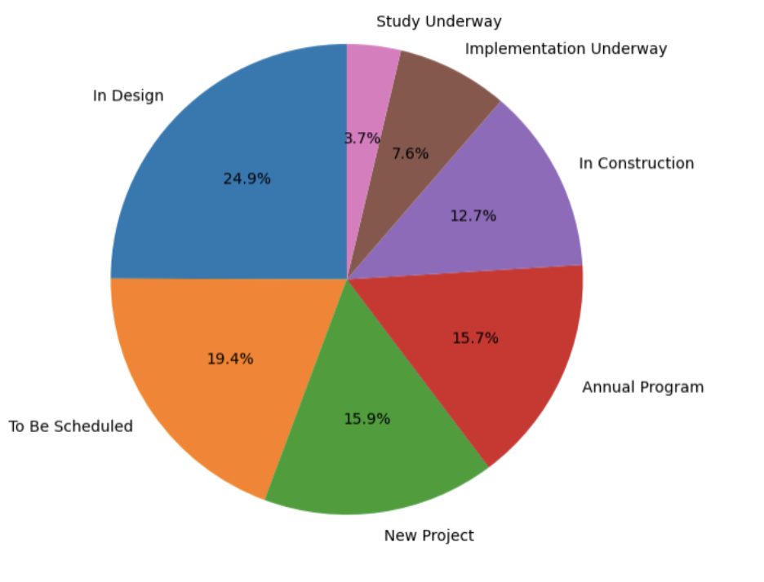
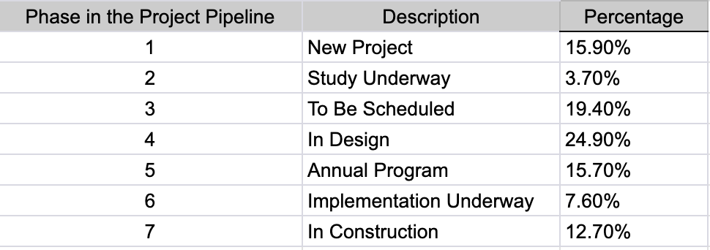
PROJECT STATUS DISTRIBUTION

Slide 16
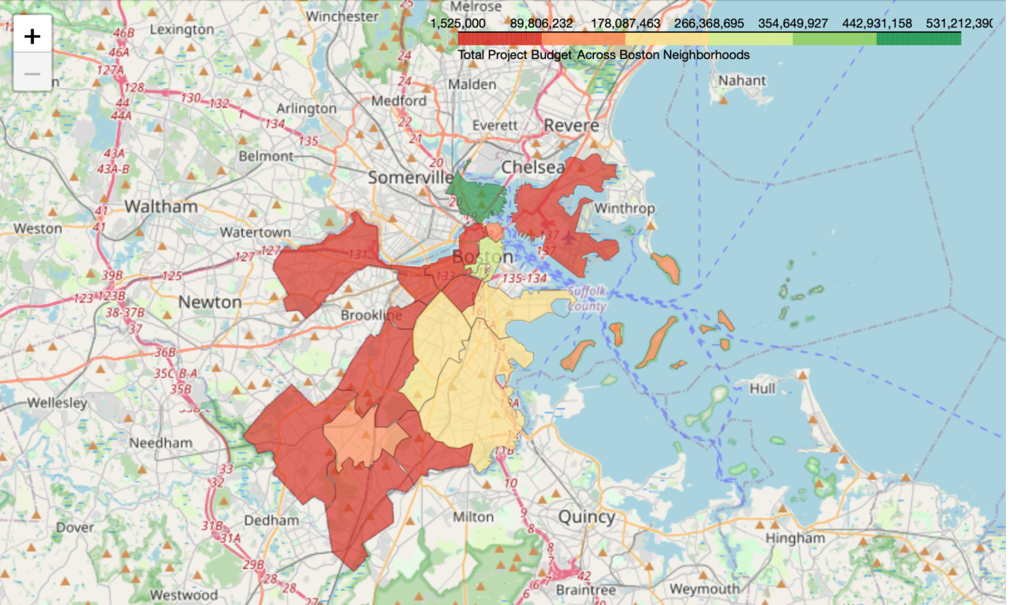
MAP REPRESENTATION OF CAPITAL BUDGET BY NEIGHBORHOOD

Slide 17
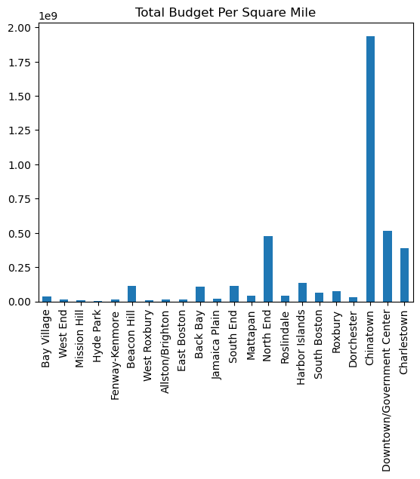
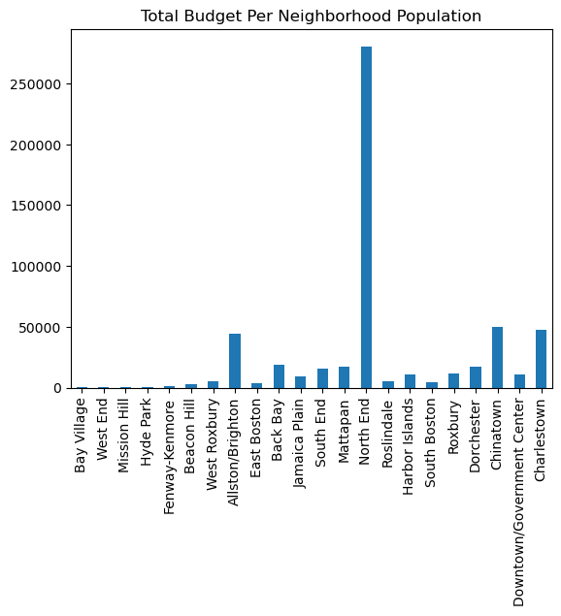
Exploring effects of area and population

Slide 18
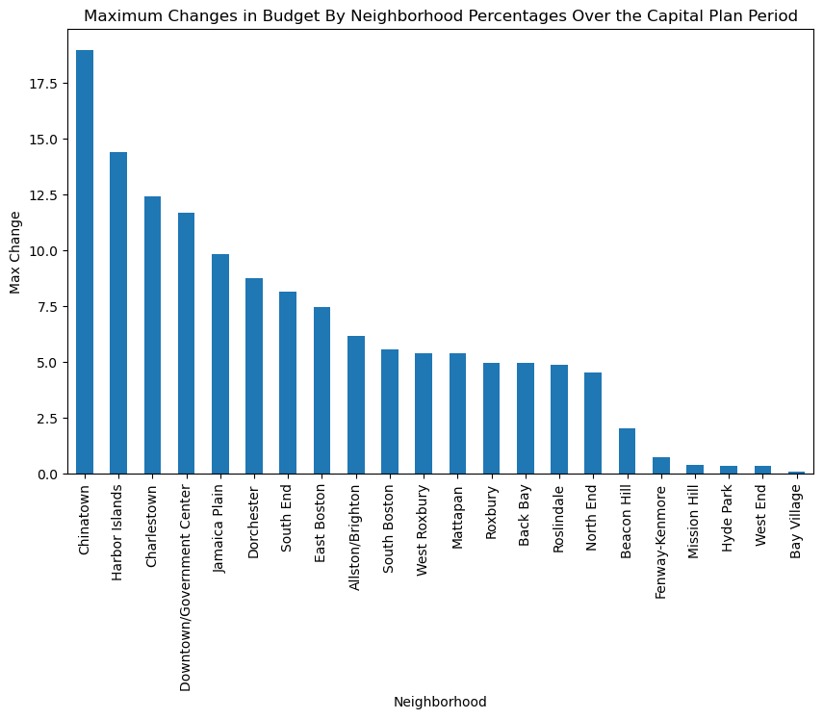
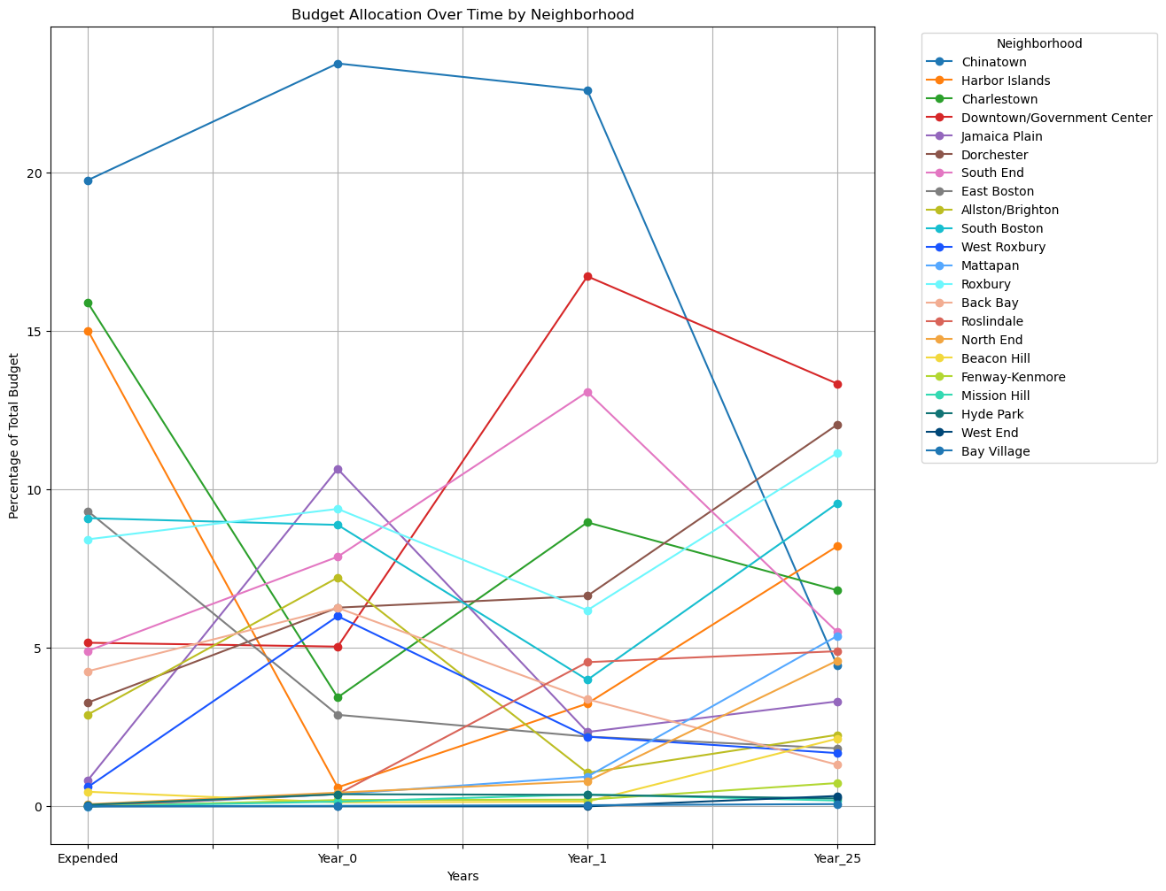
CHANGES ACROSS YEARS

Slide 19
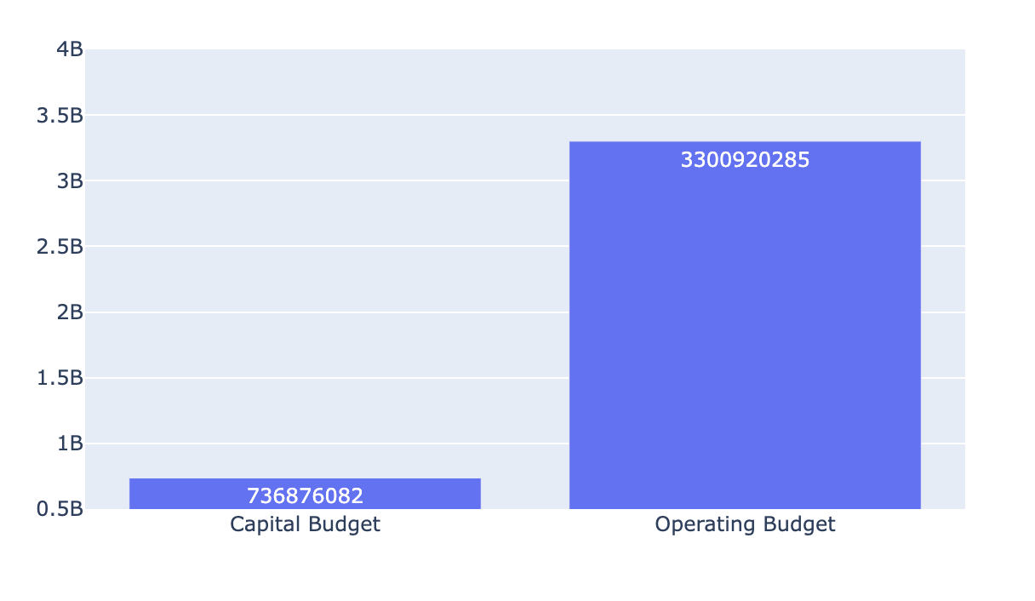
2024 CAPITAL vs OPERATING BUDGET

Slide 20
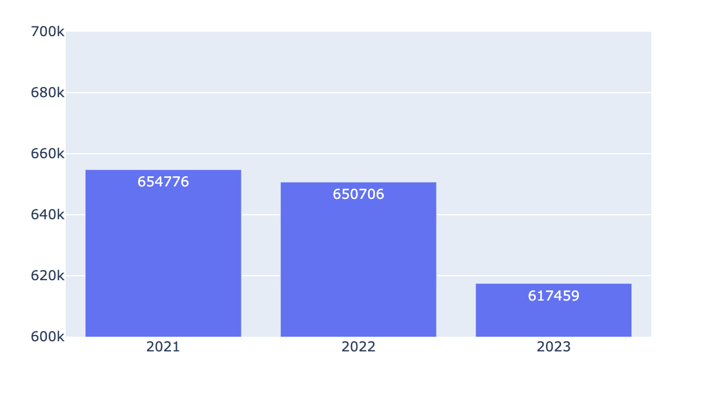
Boston POPULATION

Slide 21
6540
BOSTON CITY BUDGET PER CAPITA

Slide 22
CHALLENGES FACED

Slide 23
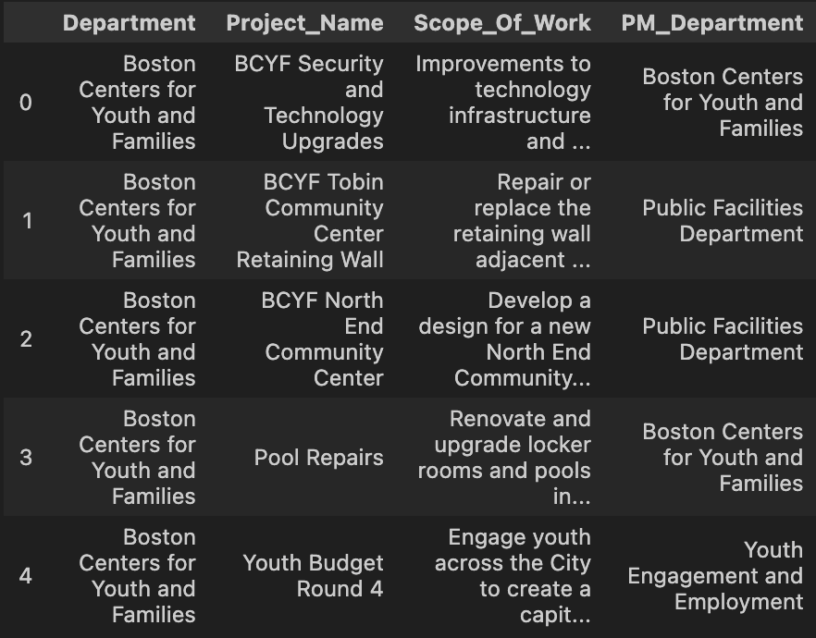
DISCREPANCY -1
Department and ‘PM_Department’ have different values. Need help from the clients in understanding differences b/w them

Slide 24
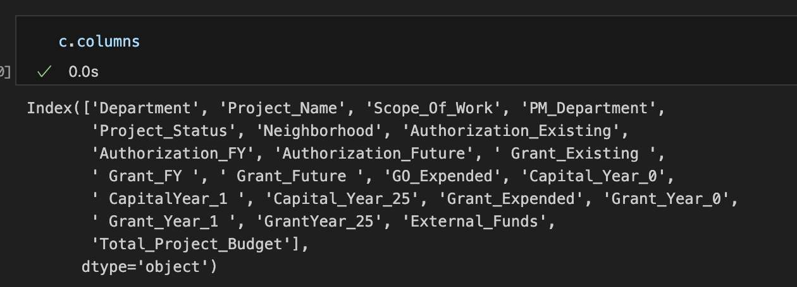
DISCREPANCY - 2
We dont understand the use of a lot of columns and many columns also have a lot of 0’s

Slide 25
EXTENSION PROJECTS

Slide 26
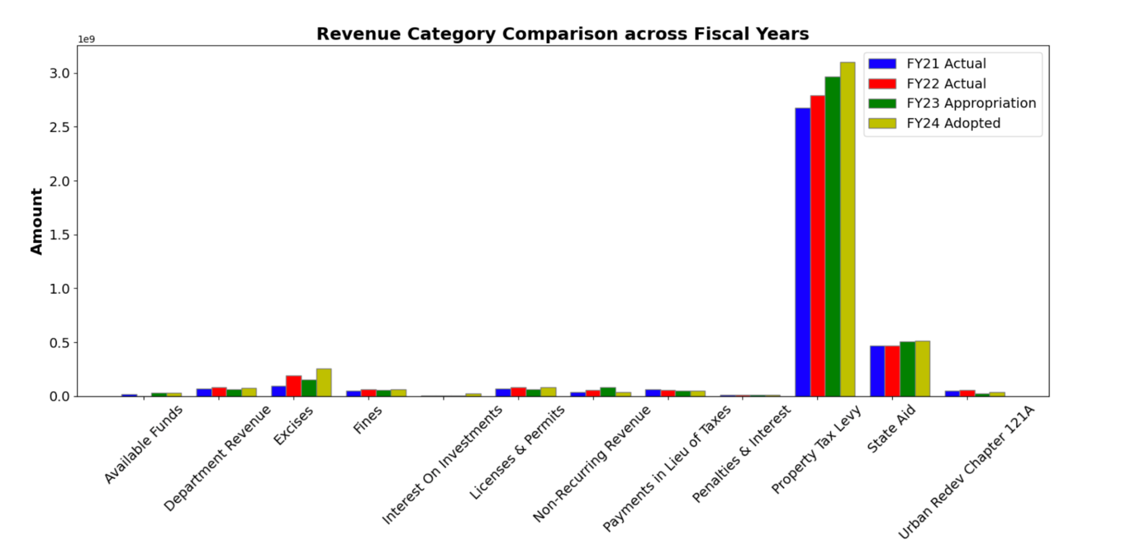
REVENUE CATEGORY COMPARISON (across fiscal years)
The "Property Tax Levy" stands out significantly, indicating its dominant role in revenue generation

Slide 27
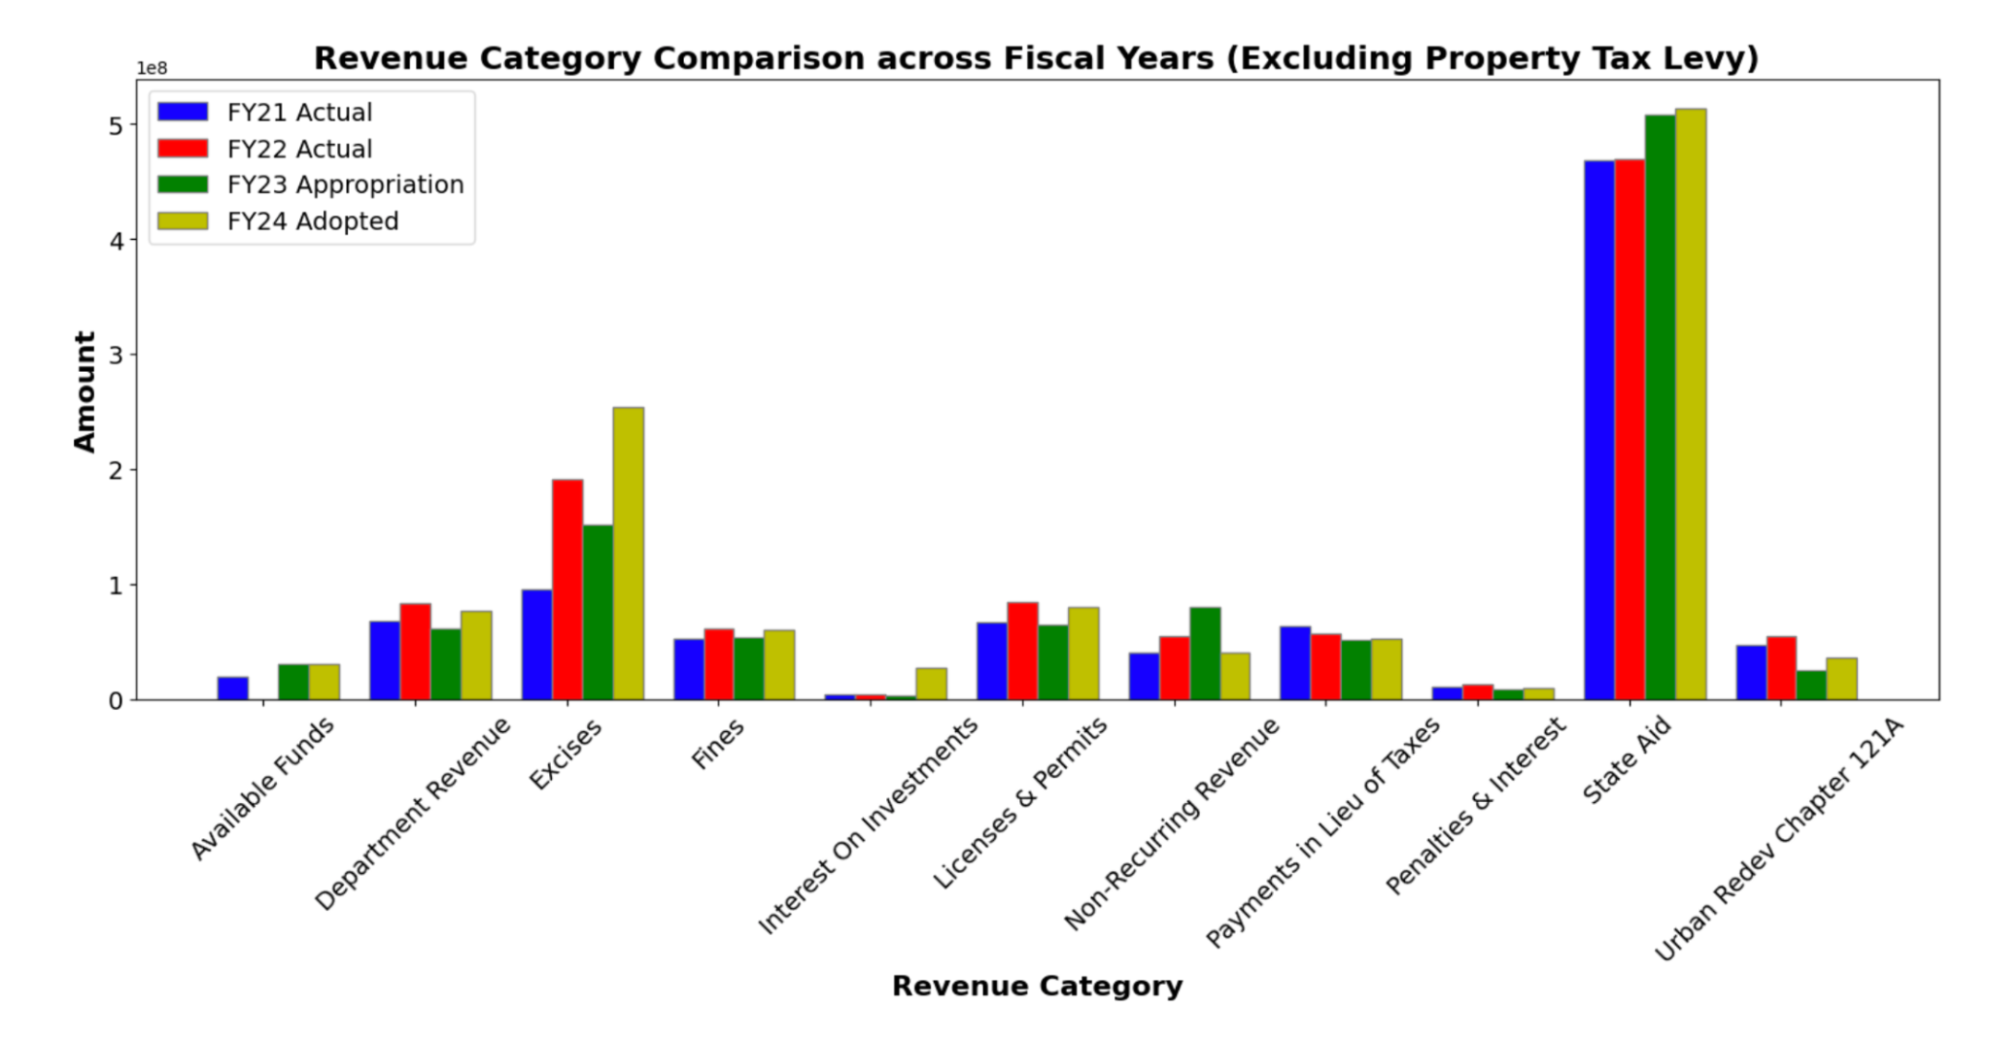
Excluding property tax
"Excises," which saw a substantial increase in the "FY24 Adopted". The majority of other revenue categories exhibit consistent trends across the years with slight fluctuations

Slide 28
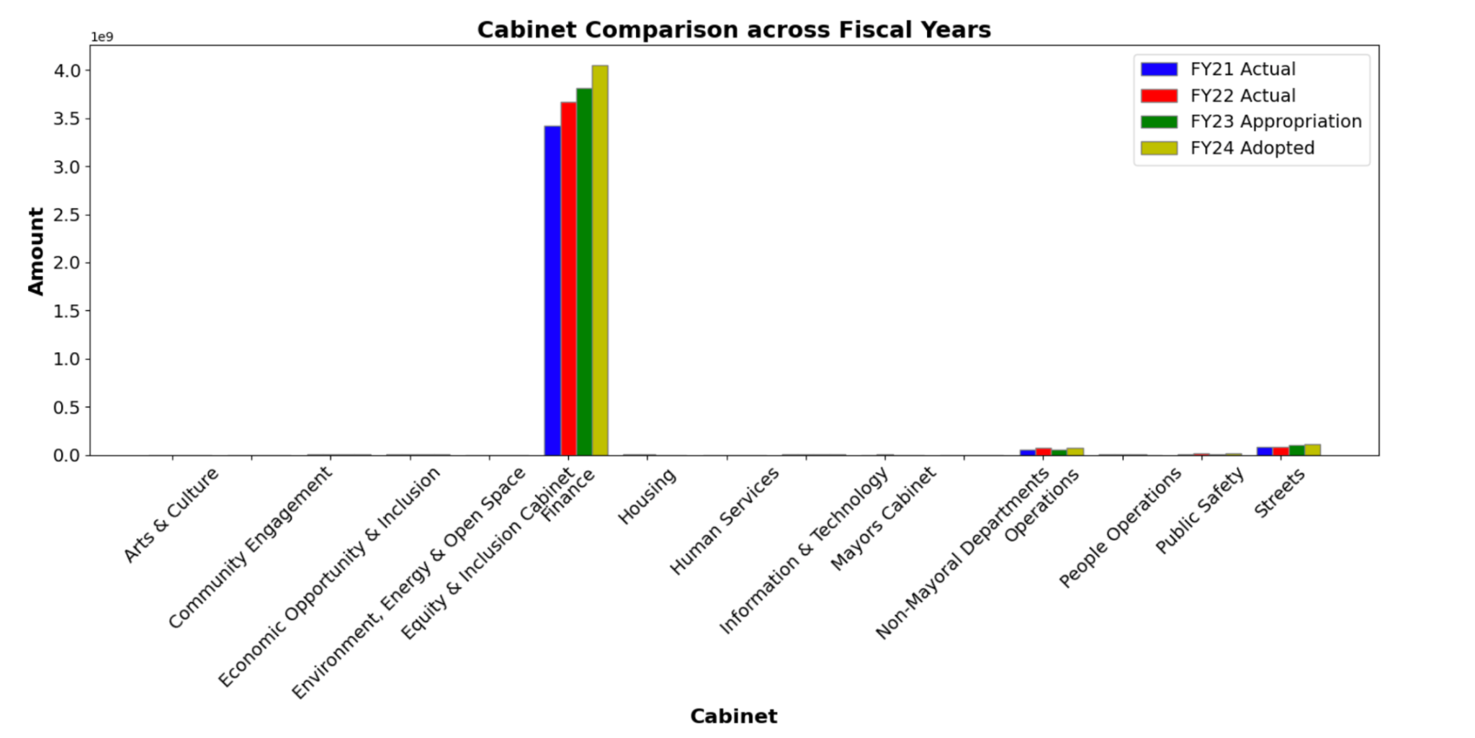
CABINET COMPARISON (across fiscal years)
Similar trend seen as was in Property Tax. Also, its clear that Property Tax category comes under ‘Finance’ Cabinet

Slide 29
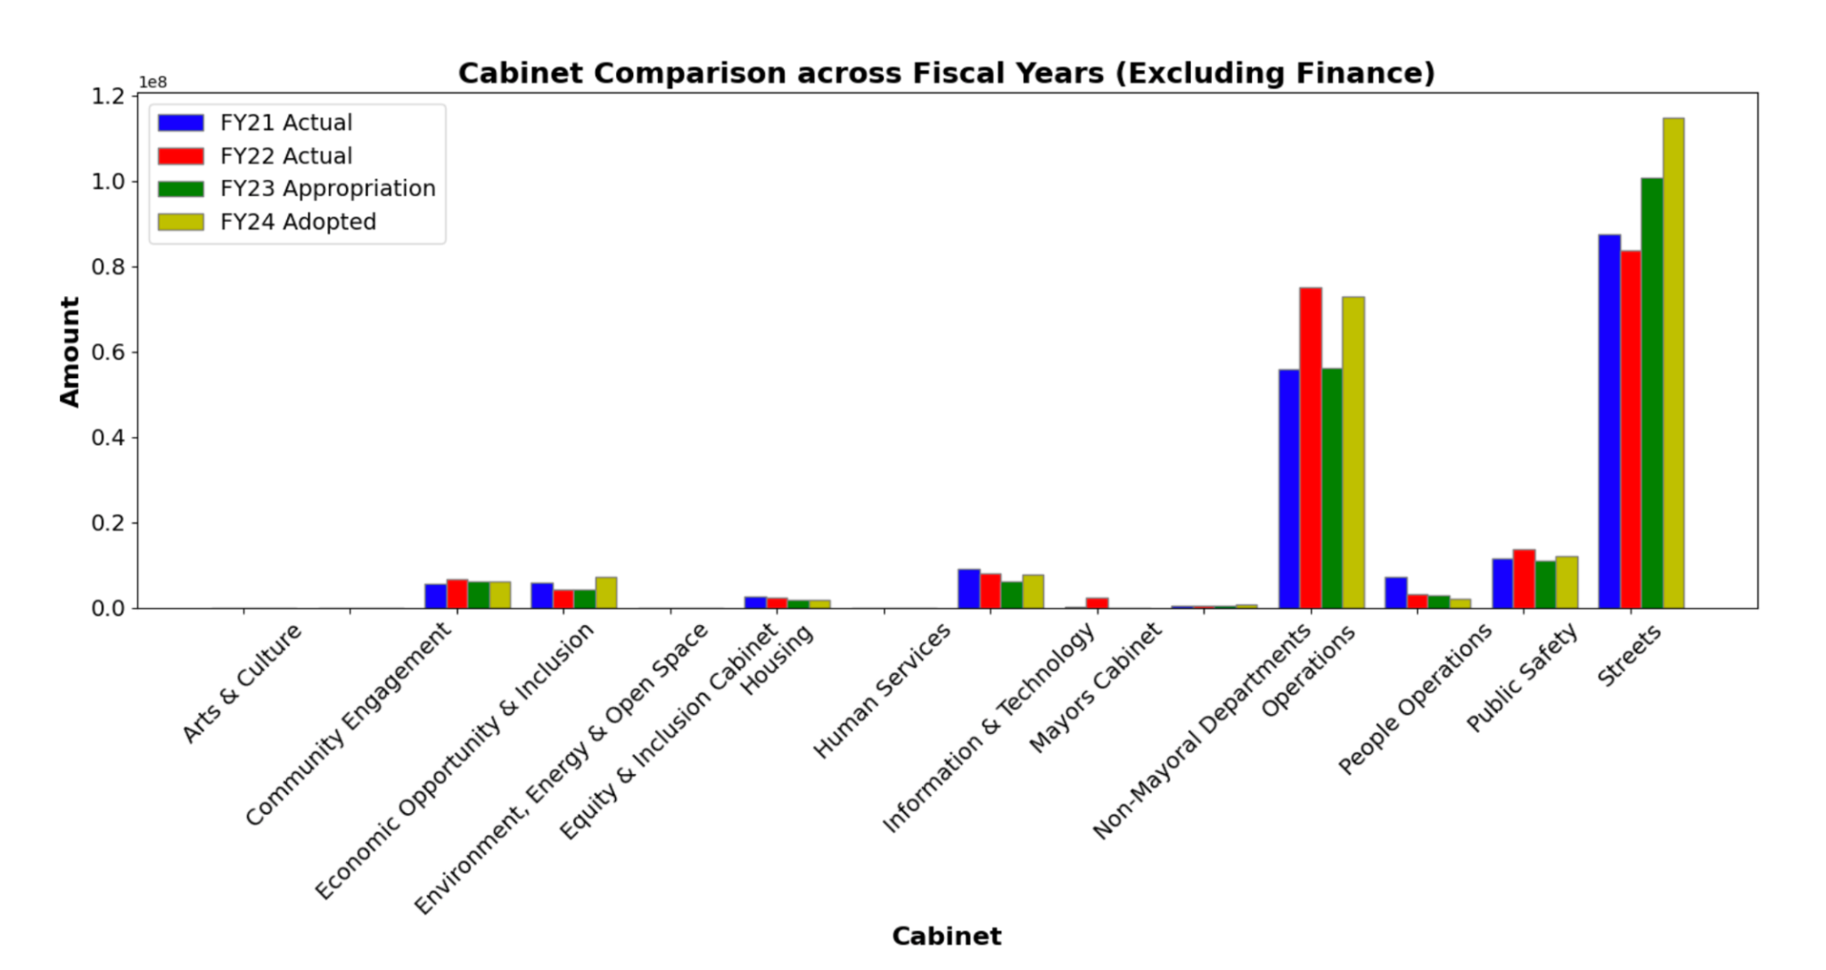
Excluding finance

Slide 30
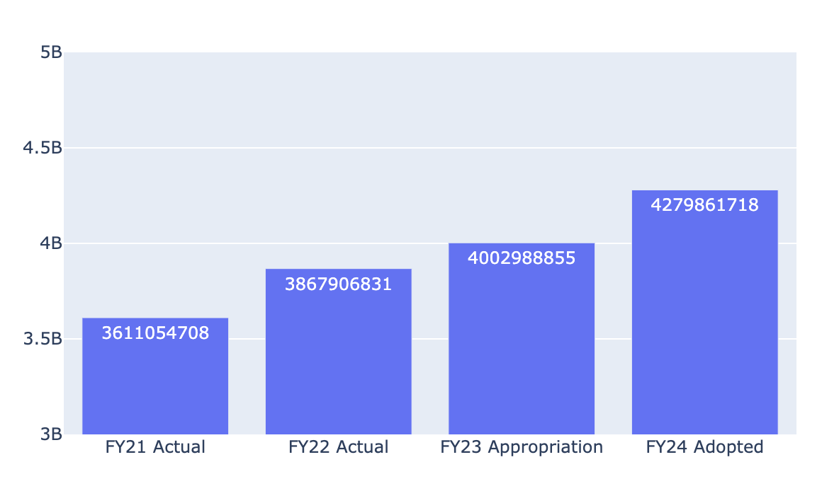
REVENUE COMPARISON (over years)

Slide 31
10.85%
Revenue increment from 2021 to 2023

Slide 32
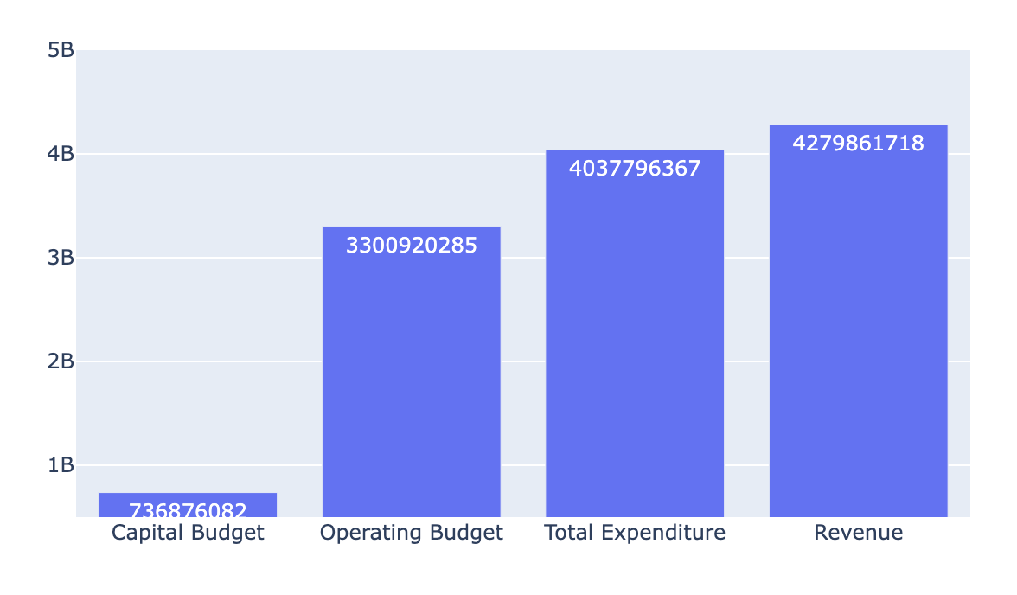
2024 PROJECTED - Revenue vs expenditure
Therefore, Boston City can afford the planned Capital Budget and Operating Budget for 2024

Slide 33
6931.4
PROJECTED BOSTON REVENUE PER CAPITA - 2024

Slide 34
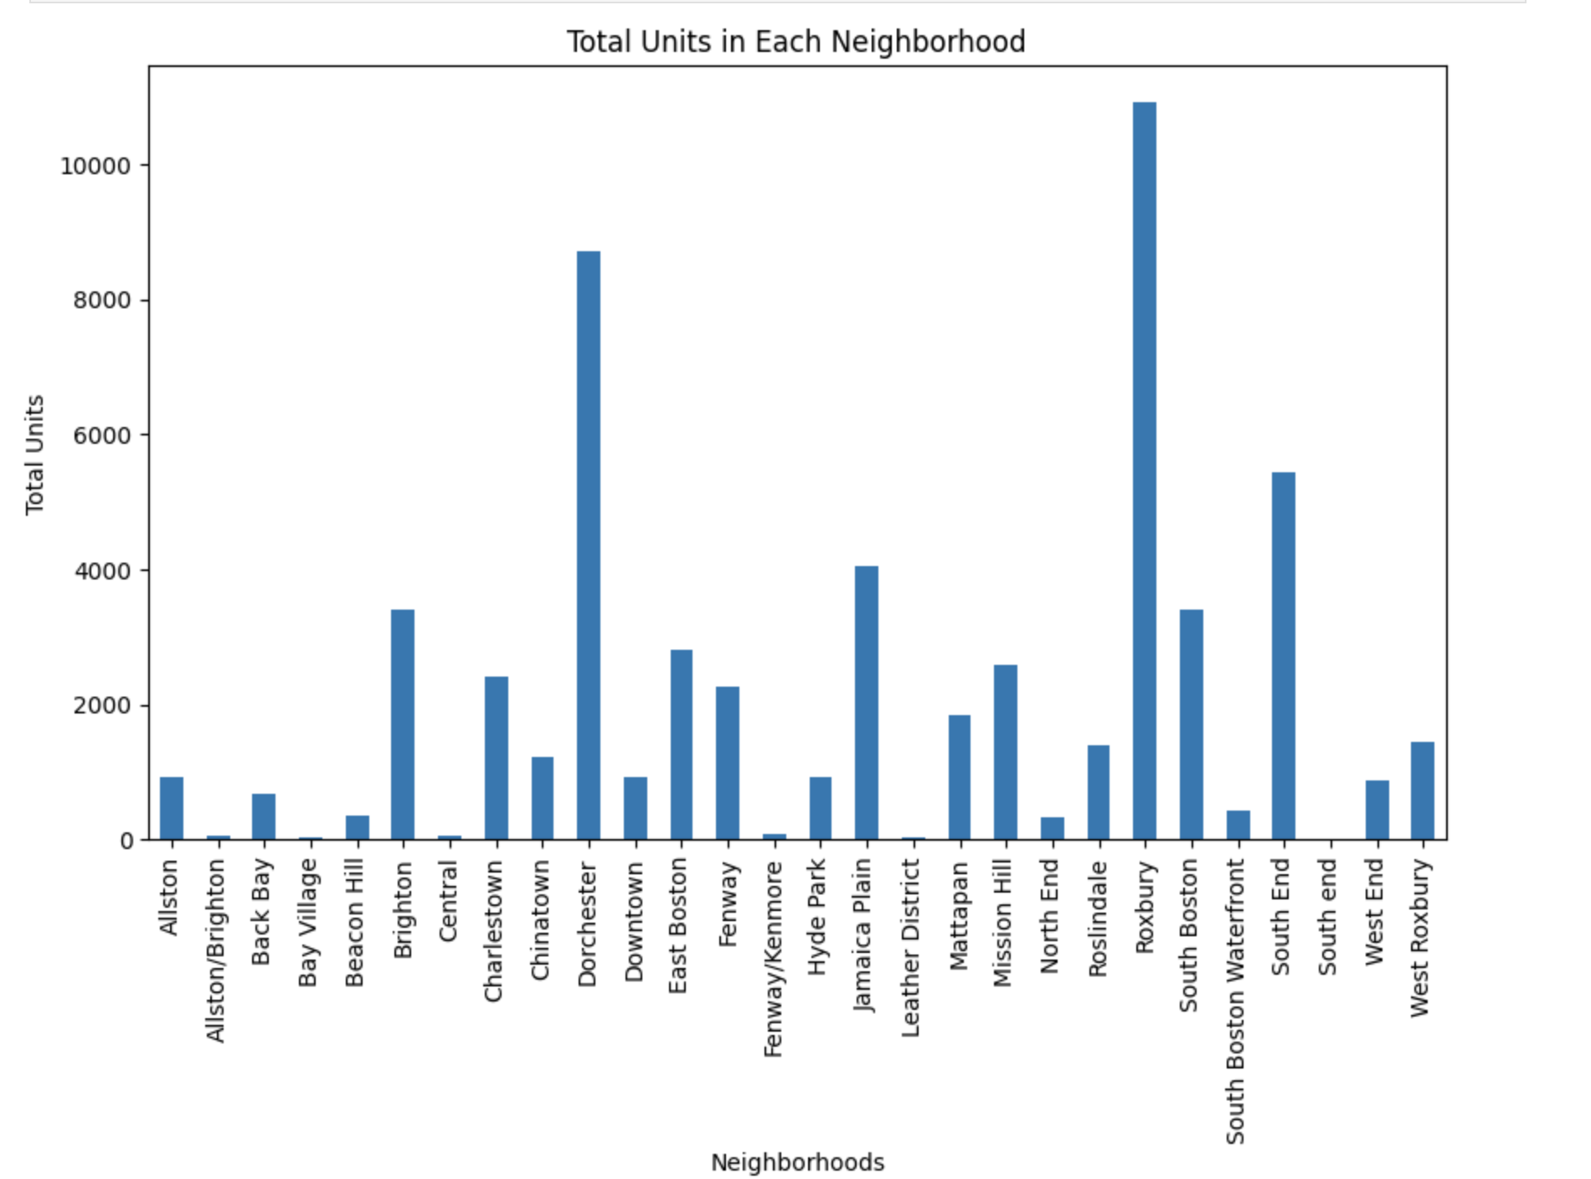
SOCIO ECONOMIC DATA

Slide 35
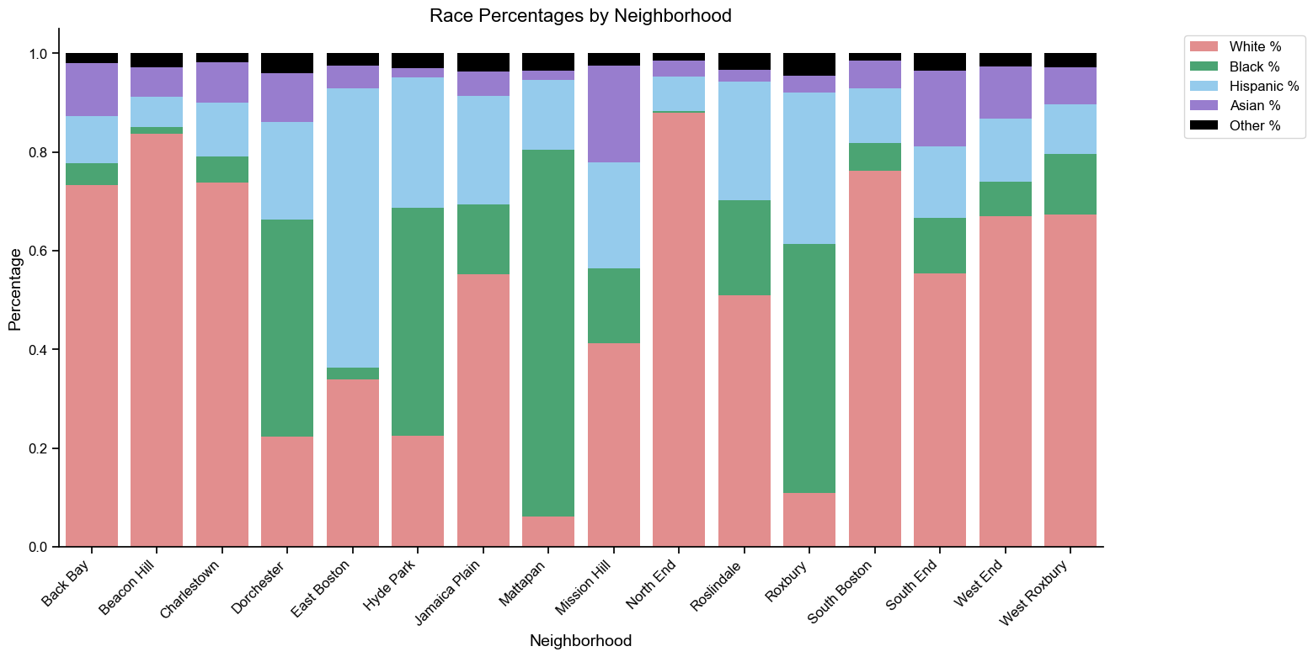
RACIAL DISTRIBUTION BY NEIGHBOURHOOD

Slide 36
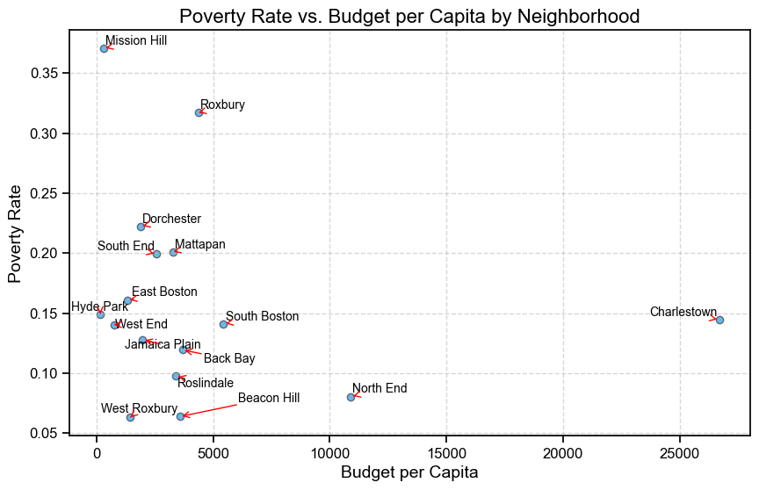
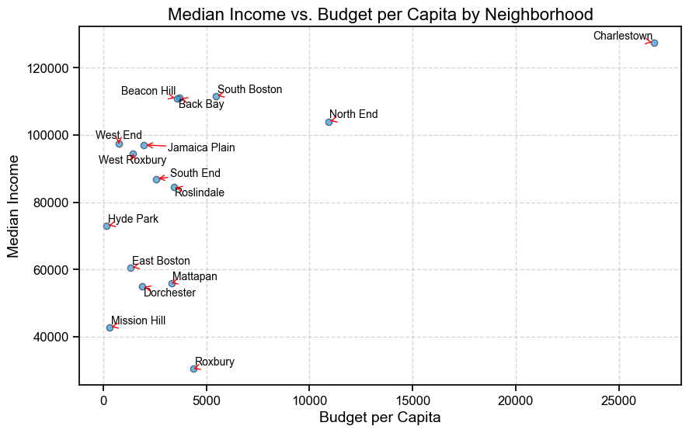
BUDGET PER CAPITA VS POVERTY RATE & MEDIAN INCOME

Slide 37
PLANNED NEXT STEPS
Explore correlation between capital expenditure and revenue generation
Map departments that come under various cabinets
Finish the revenue and socio-economic extension projects
Perform a comparison with budget distribution of Philadelphia
Identify improvement areas

Slide 38
THANK YOU!

